Slide 1
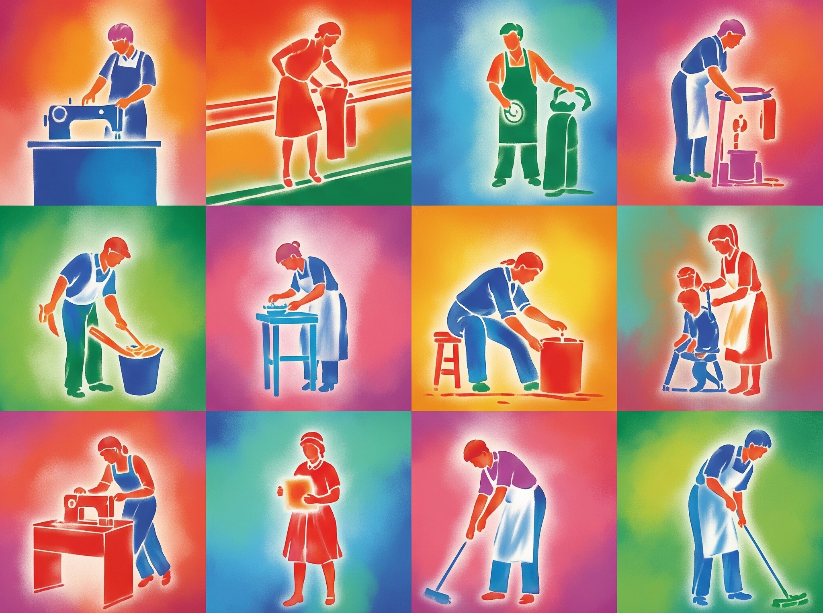
SAATHIMANDRAM
“Input: Skill. Output: Opportunity.
Engine: SaathiMandram.”
Subhayan Niyogi
Souptik Dam

Slide 2

Our Mission
Connecting Workers and Contractors — Seamlessly & Inclusively
Platform for underprivileged workers and contractors supplying labor teams
Designed for maximum accessibility, language support, and smart job matching
Bridges the gap between industries and untapped workforce potential

Slide 3

Seamless Access for All
OTP-Based Login System
Log in from any device — cybercafé, friend’s
phone, or home
No need to remember passwords
Useful for users without consistent access
to electronics
Ensures easy, secure access for all

Slide 4
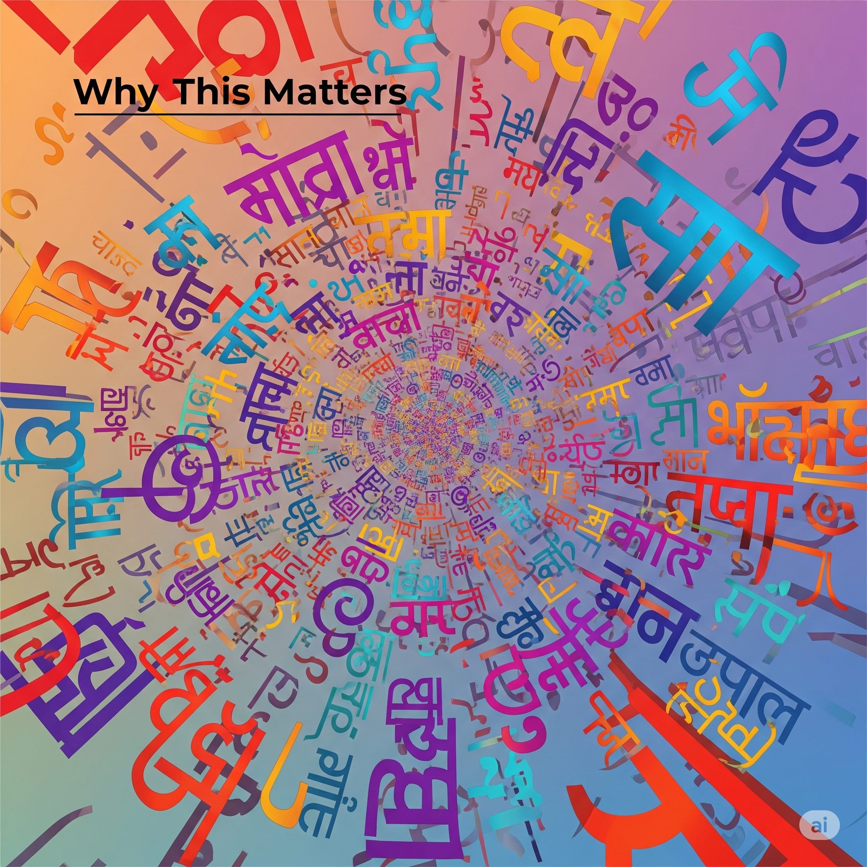
Breaking Language Barriers
Google Translate Integration
Supports 14+ Indian languages
Users can view and post in their native language
Smooth cross-lingual communication between workers and contractors
Promotes inclusivity across regions and communities

Slide 5

Smart Job Matching
Job Sorting Algorithm
Matches based on skills, location, availability, and preferences
Ensures relevance, efficiency, and better outcomes

Slide 6
The following slides show a glipse into our website; how the recruiters and job finder connect

Slide 7
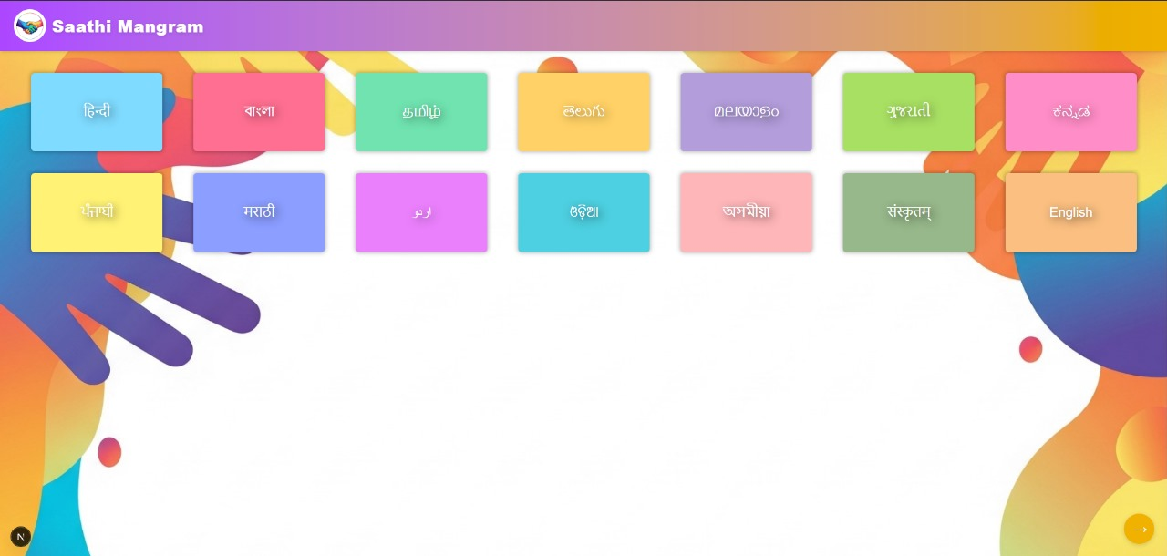

Slide 8
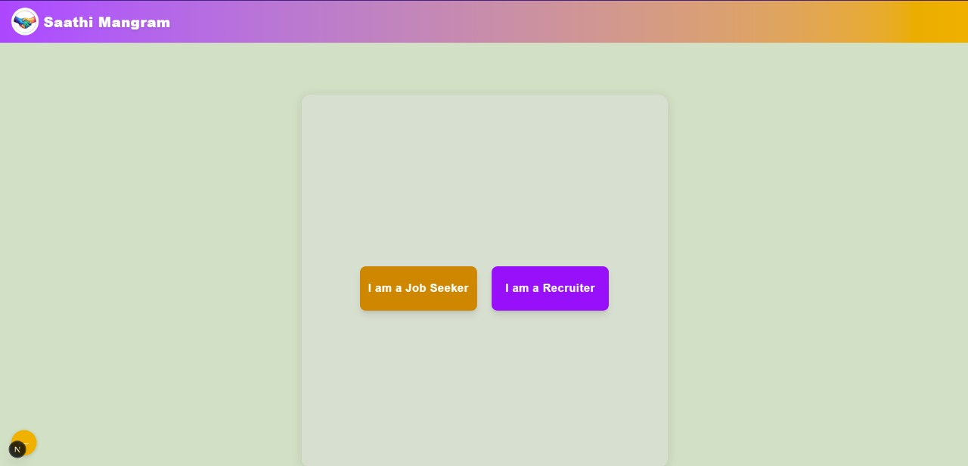

Slide 9
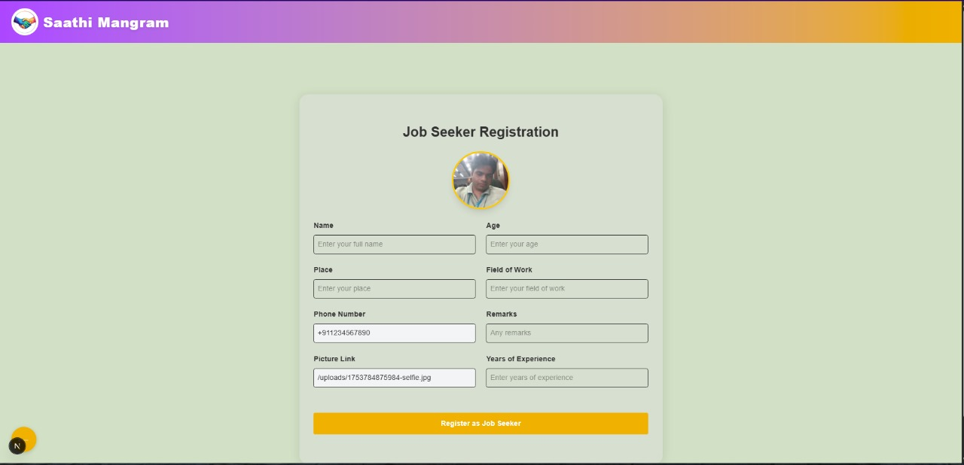

Slide 10
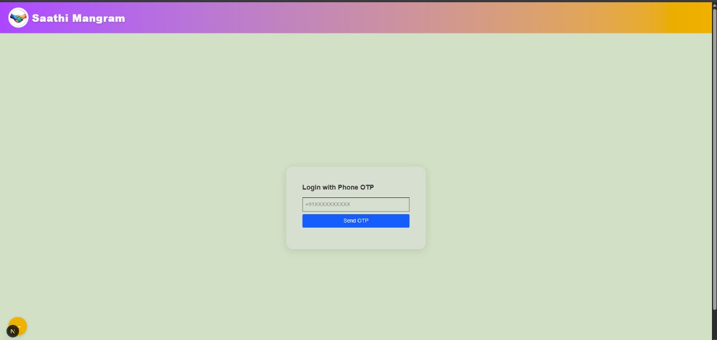
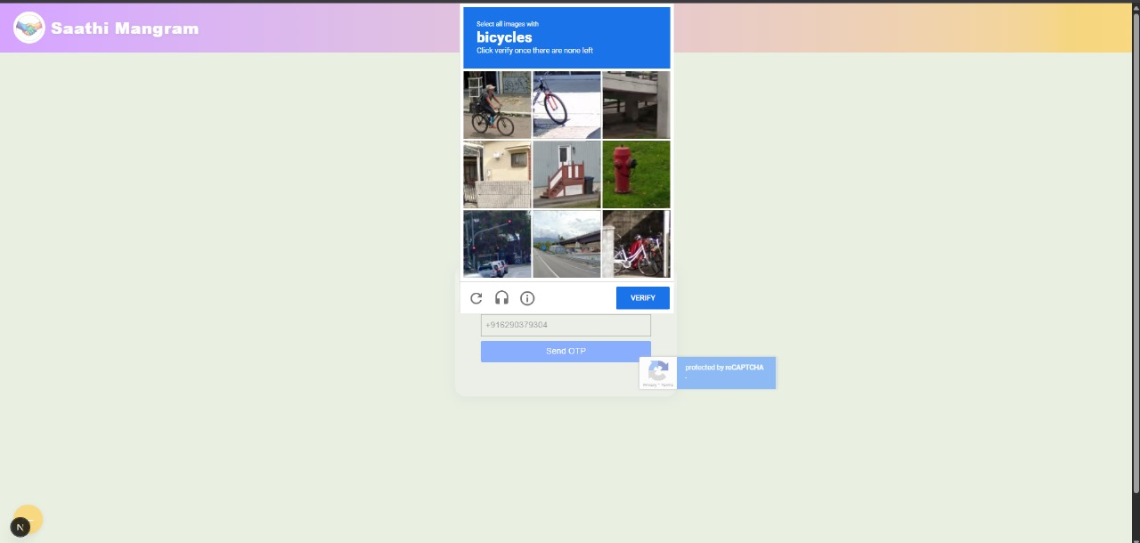
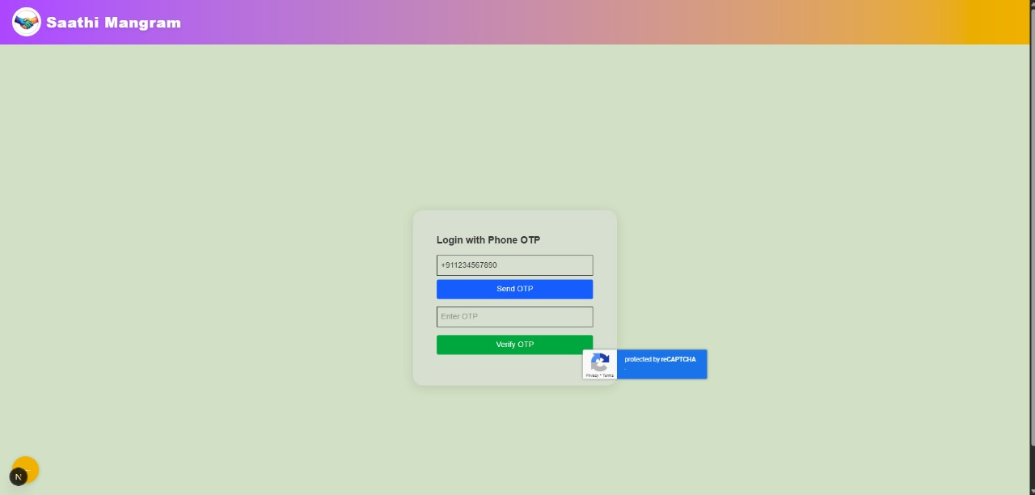
This is our login page

Slide 11
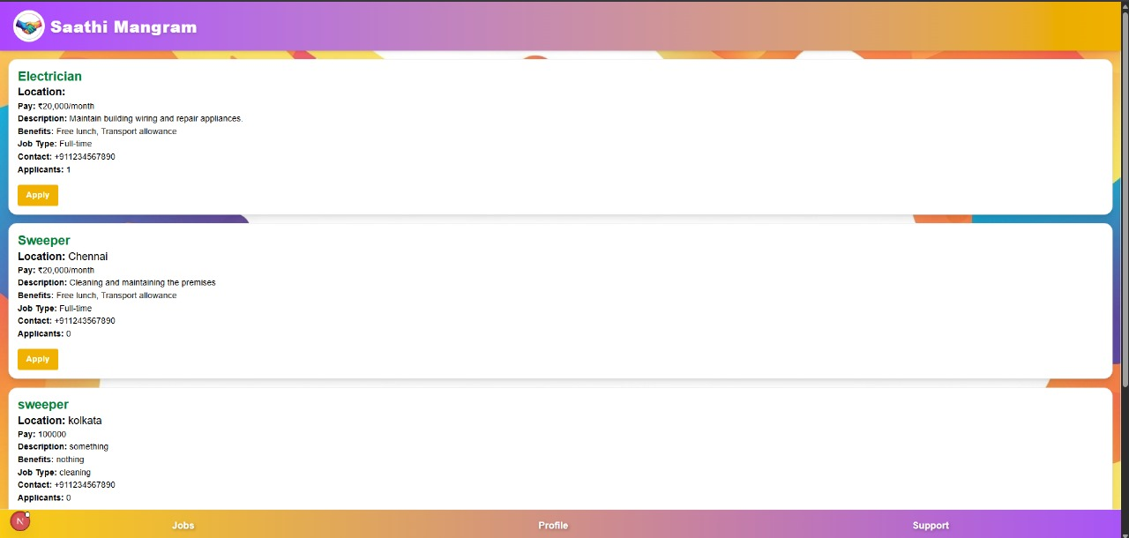

Slide 12
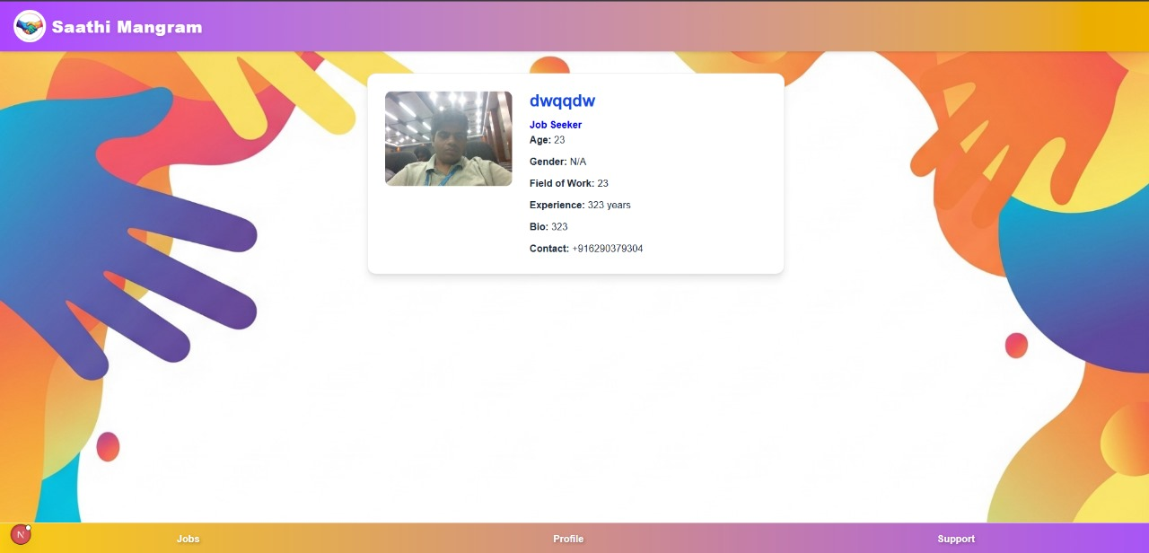

Slide 13
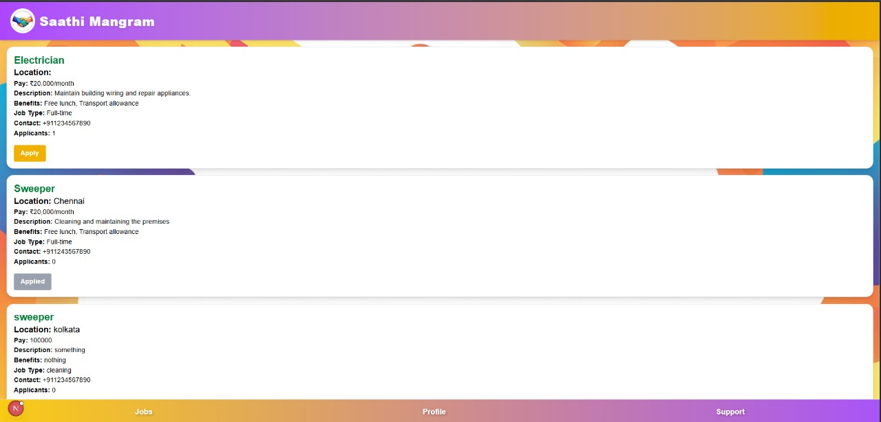

Slide 14
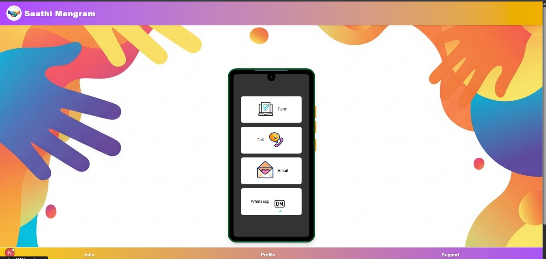

Slide 15
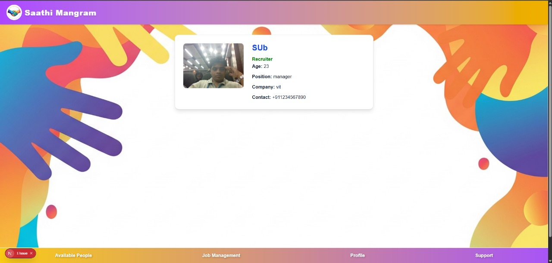
This is the recruiter side

Slide 16
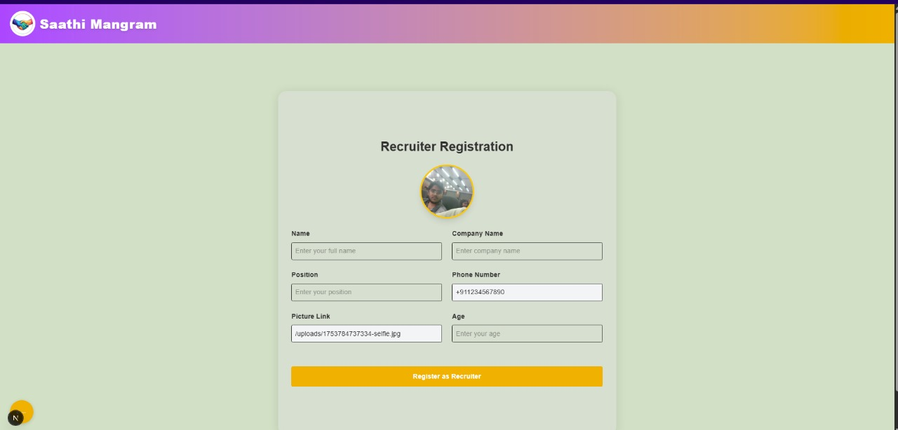

Slide 17
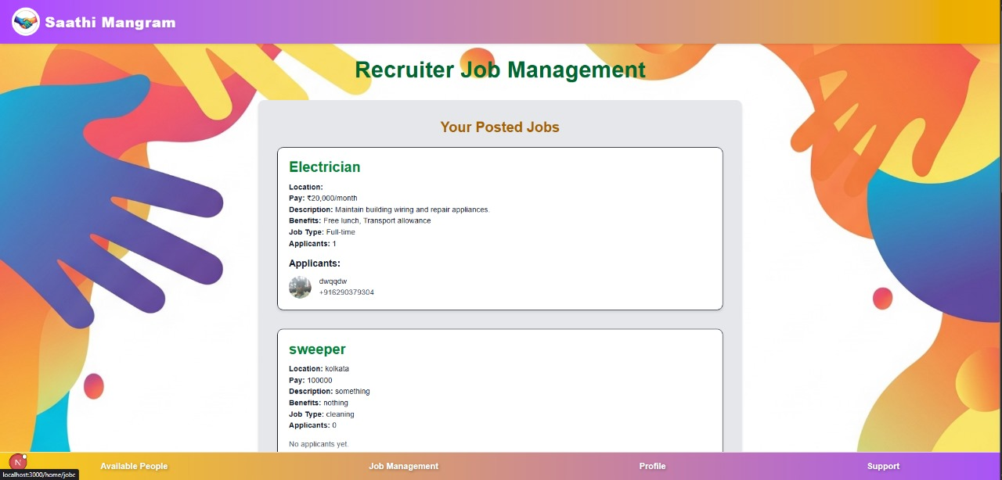

Slide 18
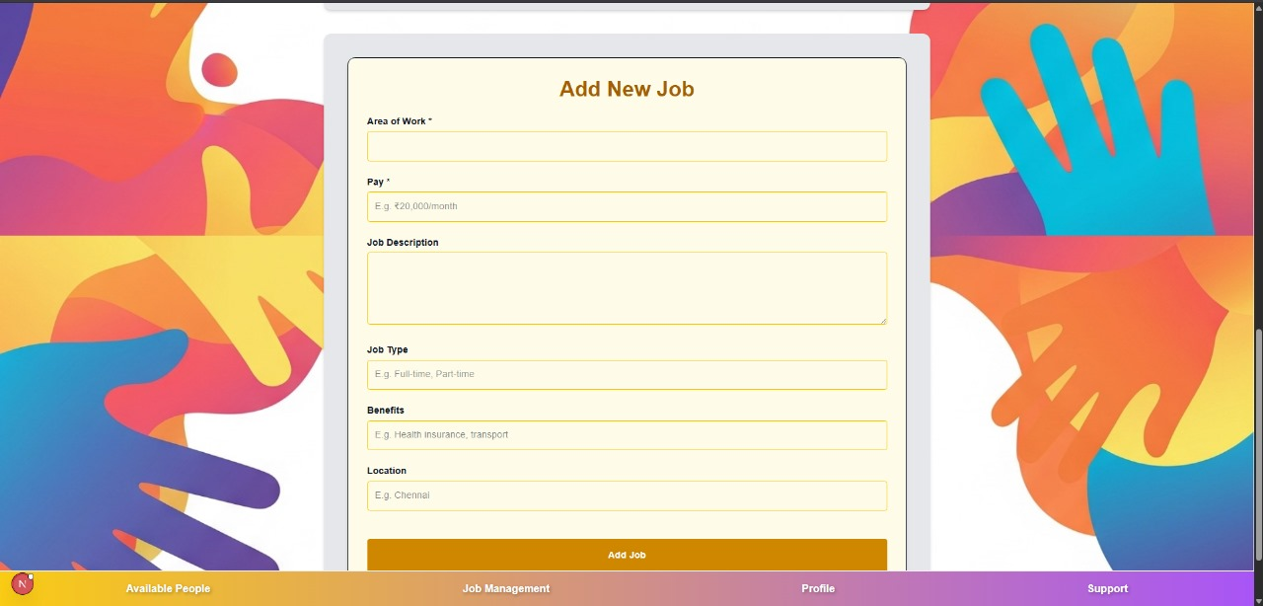

Slide 19
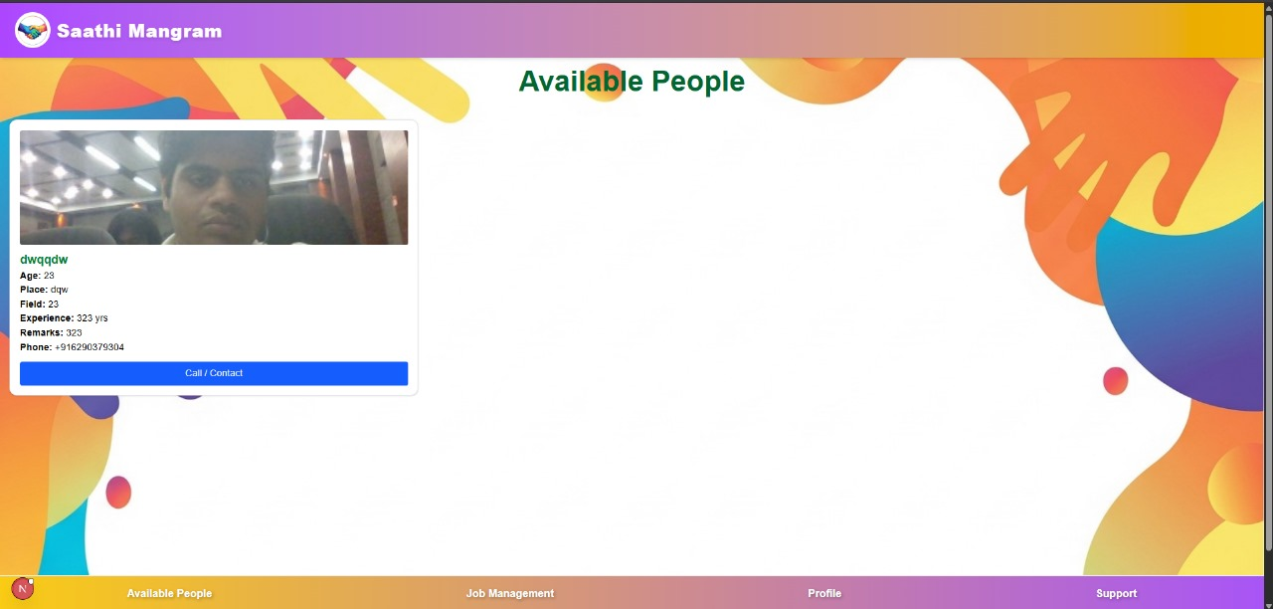

Slide 20
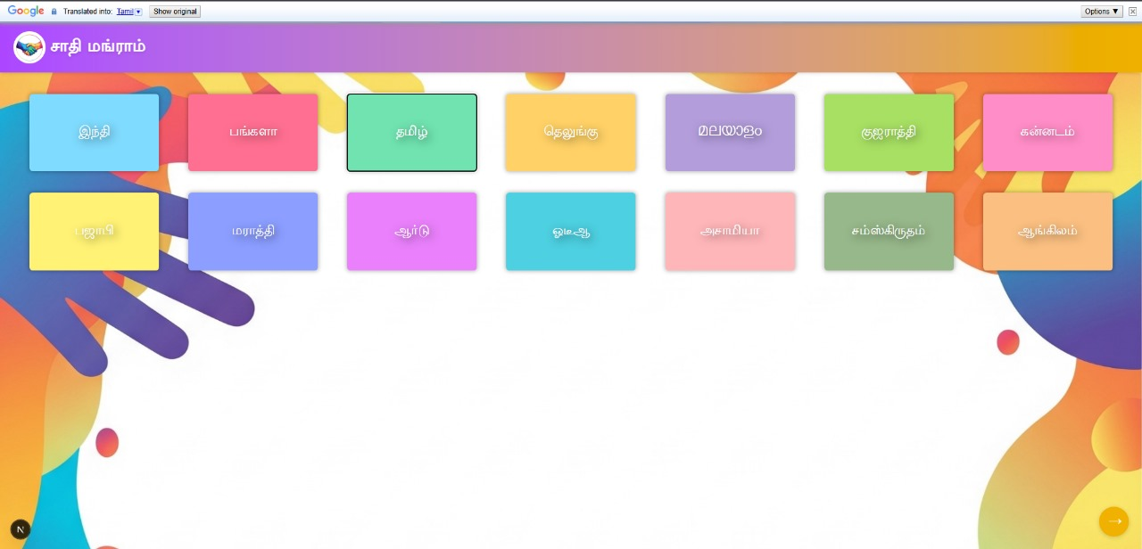
The following are examples of the language feature

Slide 21
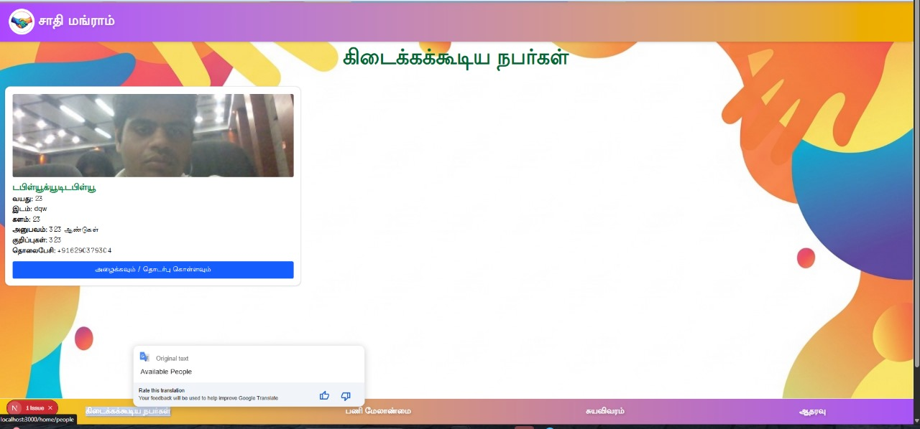
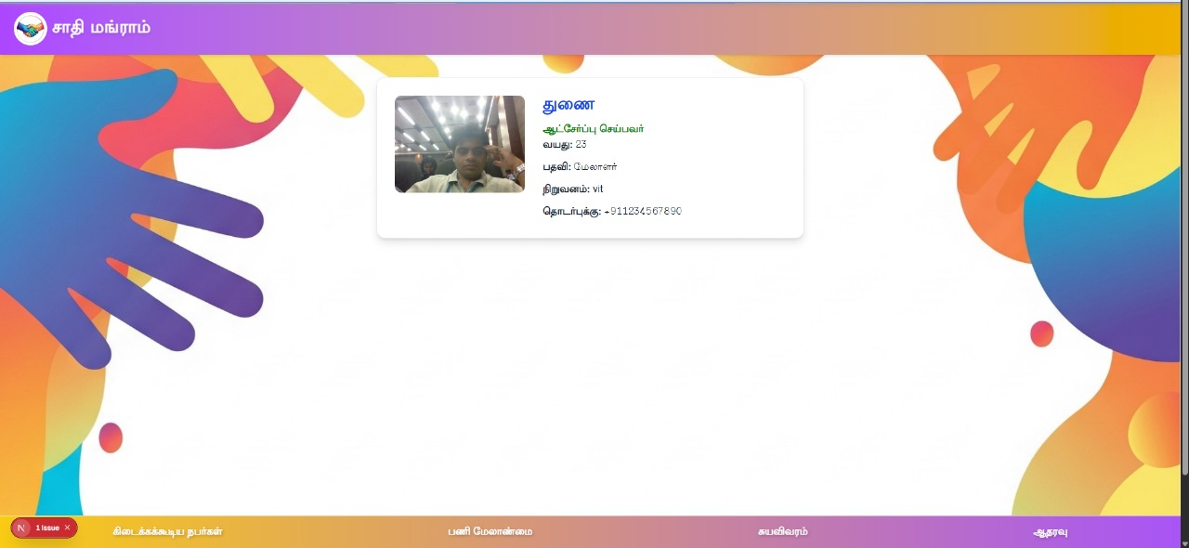
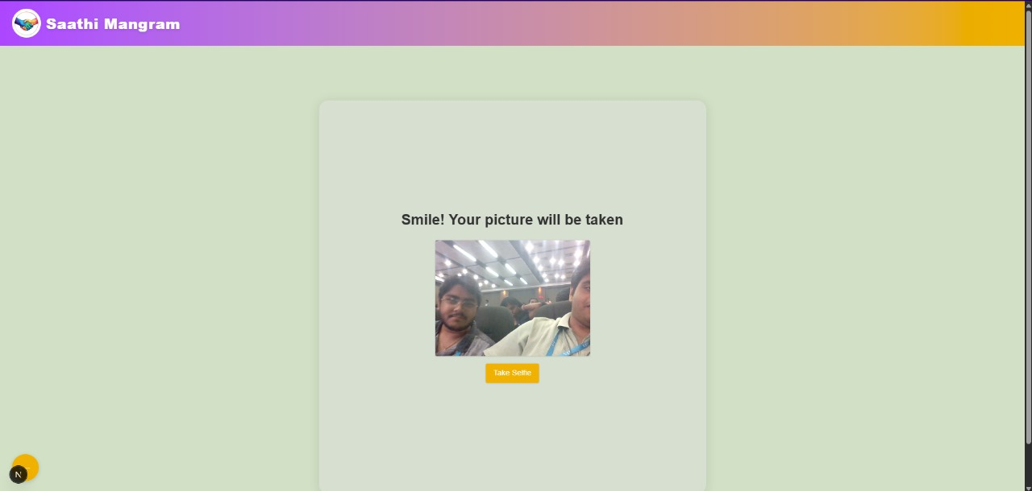
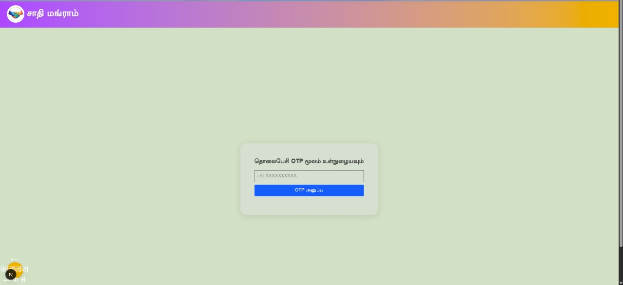

Slide 22
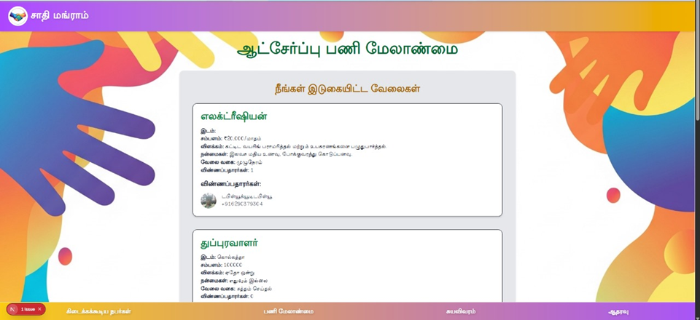

Slide 23

Why This Matters
Empowering a New Workforce
Breaks technological, linguistic, and educational barriers
Builds trust between contractors and workers
Connects underutilized talent to genuine opportunities
Helps industries find reliable, skilled teams quickly

